Slide 1
CUDA Total Variation Denoise
赵申剑
陈蕾宇
徐文康
2015.01.16

Slide 2

Basic Model
Given an image $Y∈R^{m×n}$, the discrete version of the Rudin-Osher-Fatemi (ROF) model is:
$$\min_{X}{\frac{1}{2}{\left\|X−Y\right\|}_{F}^{2}}+λ{\left\|X\right\|}_{TV}$$
$${\left\|X\right\|}_{TV}=\sum_{i=1}^{m}{\sum_{j=1}^{n}{{\left\|D_{i,j}X\right\|}_{2}}}$$

Slide 3
Solution
Serial Optimization via Lagrange
ADMM (Alternating Direction Method of Multipliers) based method: FAD(Fast ADMM for TV Models)
ICML2014
A Highly Scalable Parallel Algorithm for Isotropic Total Variation Models

Slide 4
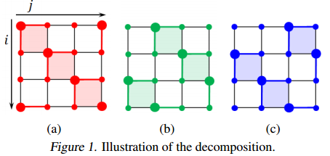


ADMM Approach
$$\min_{Z,X1,X2,X3}{\frac{1}{2}{\left\|Z−Y\right\|}_{F}^{2}}+λ{\left\|X_{k}\right\|}_{TV}$$
$$s.t. X_{k}=Z$$

Slide 5
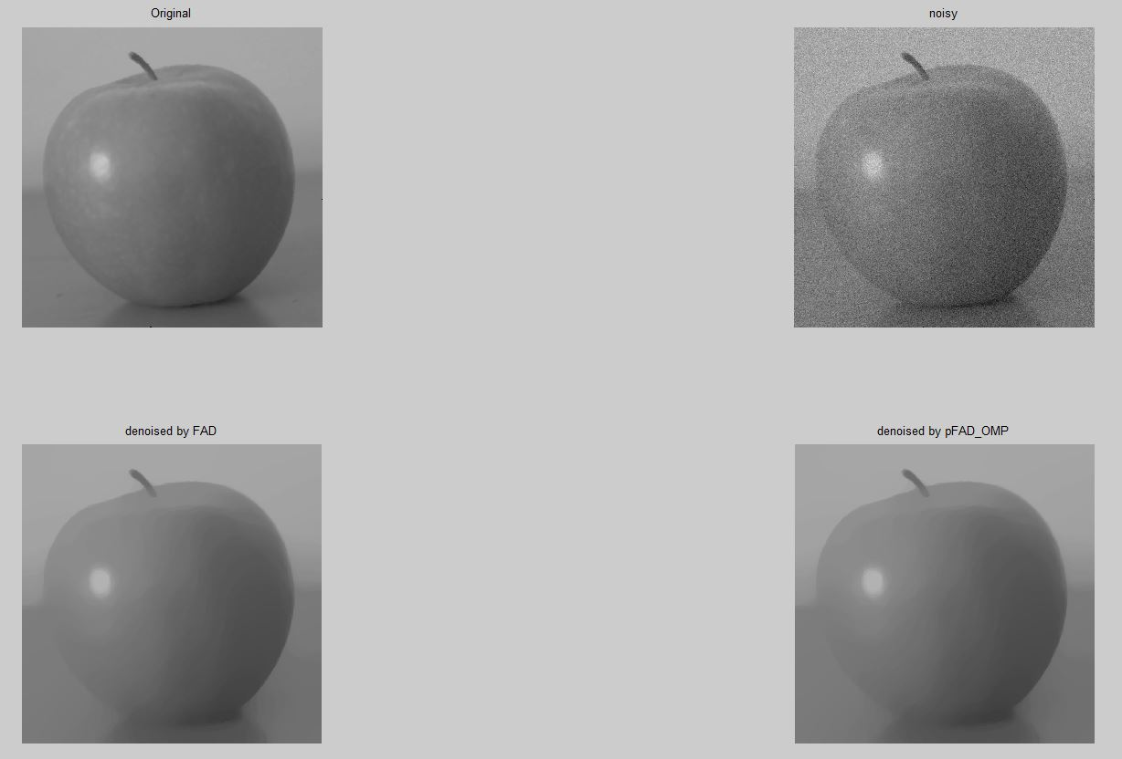
Matlab Result
Single Channel:
Matlab Serial: 11390.7 ms
Matlab Parallel: 5188.9 ms

Slide 6
Our Step
Pure C++
OpenMP
CUDA
Optimization
Serial : 34454.399 ms
OpenMP: 17363.747 ms (i5 four cores)
CUDA : 1758.133 ms (GT540M)
Opt : 1184.665 ms (GT540M)

Slide 7
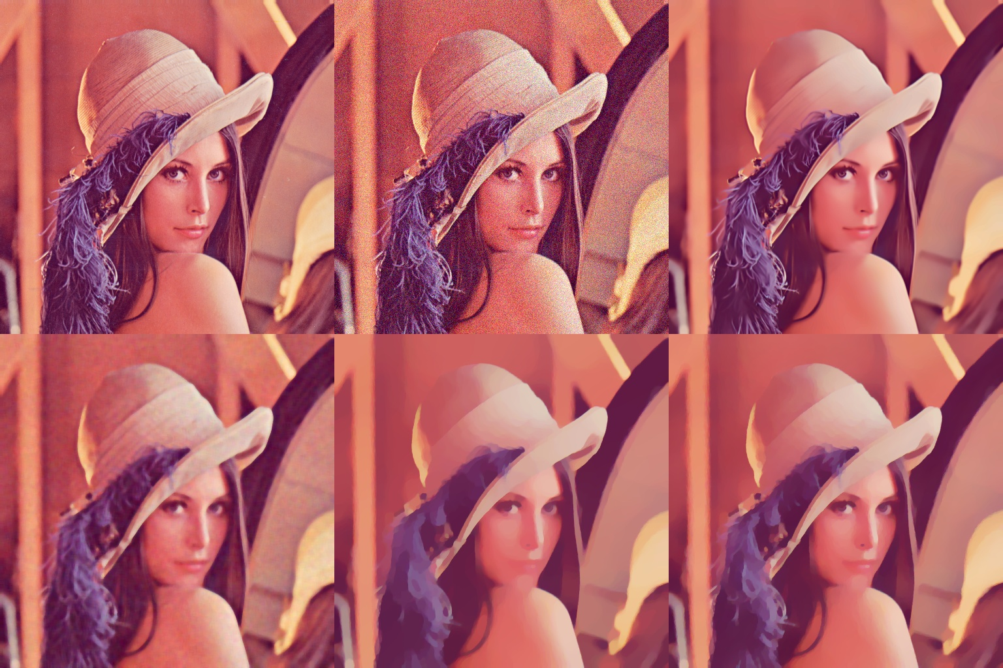
Result

Slide 8
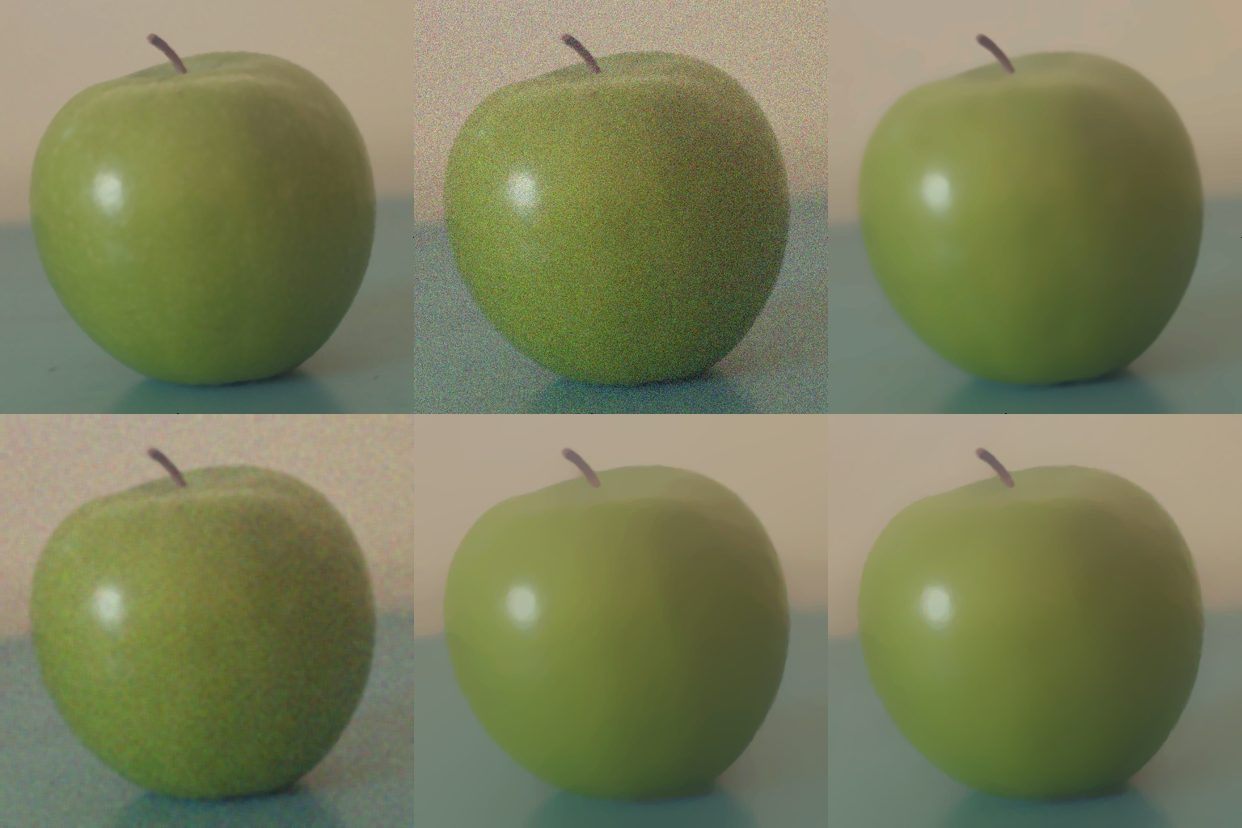
Result

Slide 9
Optimization
double to float: 1.26s → 1.01s
using double buffer: 1.01s → 933ms
using for newton and device copy: 933ms → 742ms

Slide 10
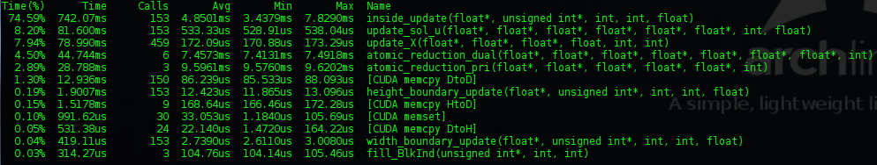
Limitation
inside_update, because of newton iteration.
Memory pattern.

Slide 11
Division of Labor
赵申剑 | Interior update, Tests | 34%
陈蕾宇 | Boundary update, Tests | 33%
徐文康 | Stop condition, Tests | 32%

Slide 12
Thanks!

